Slide 1
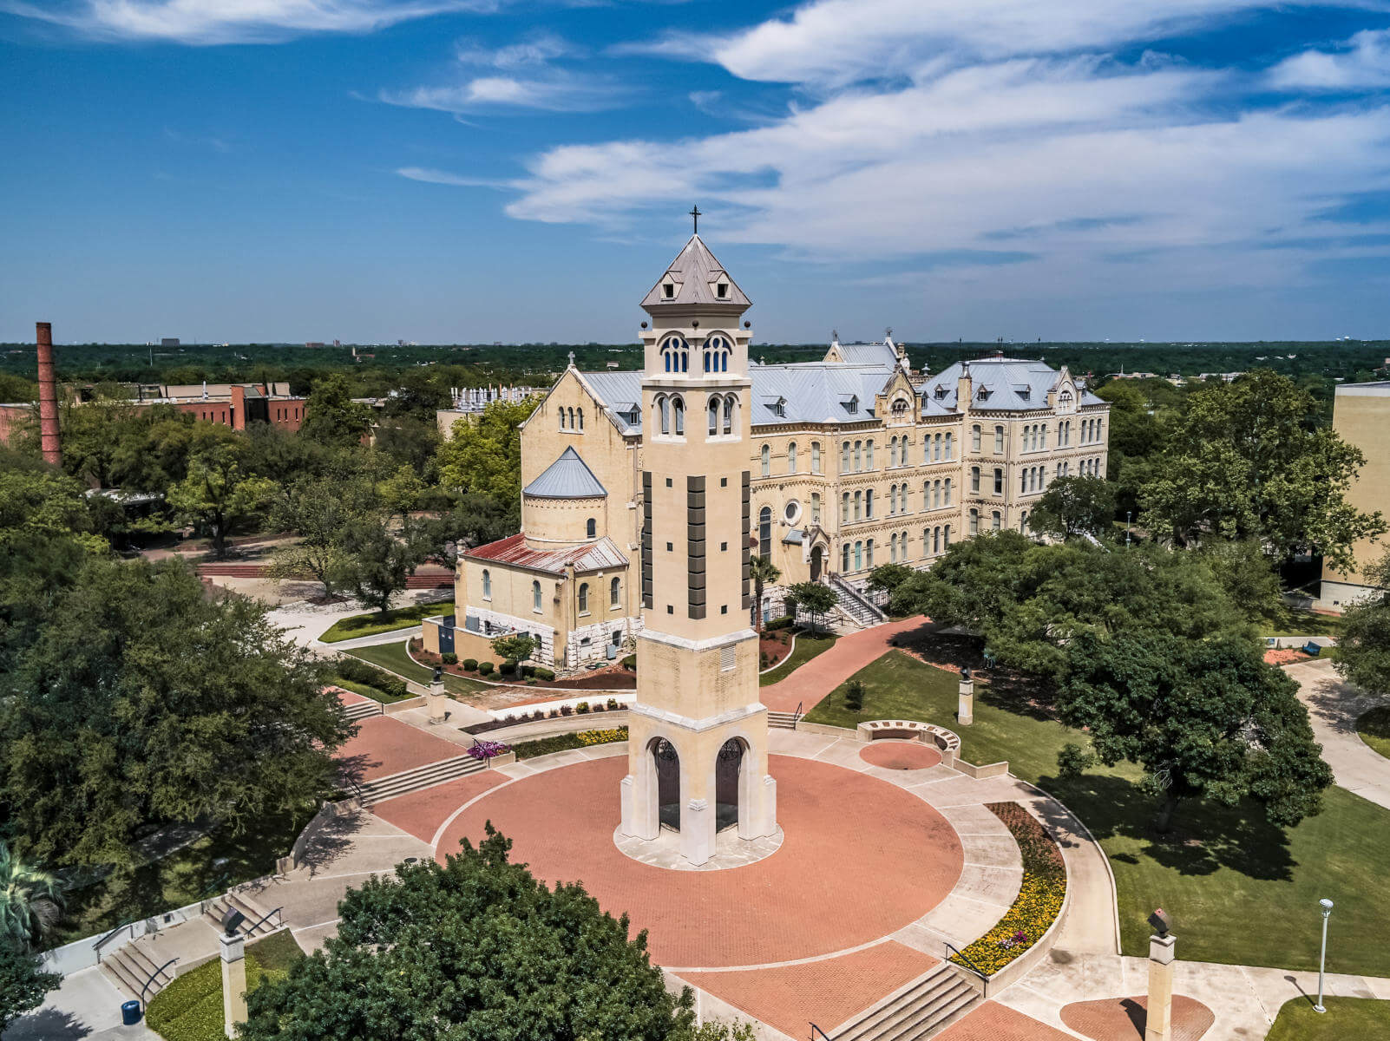
Streamlining Text Encoding Initiative (TEI), International Image Interoperability Framework (IIIF), and Mirador: Theoretical and Practical Considerations for Interactive Critical Editions
Todd Hanneken
St. Mary’s University, San Antonio
thanneken@stmarytx.edu
https://palimpsest.stmarytx.edu/thanneken/
@thanneken@hcommons.social
Notes:
https://cdn.stmarytx.edu/wp-content/uploads/2021/03/DJI_0900-2.jpg

Slide 2
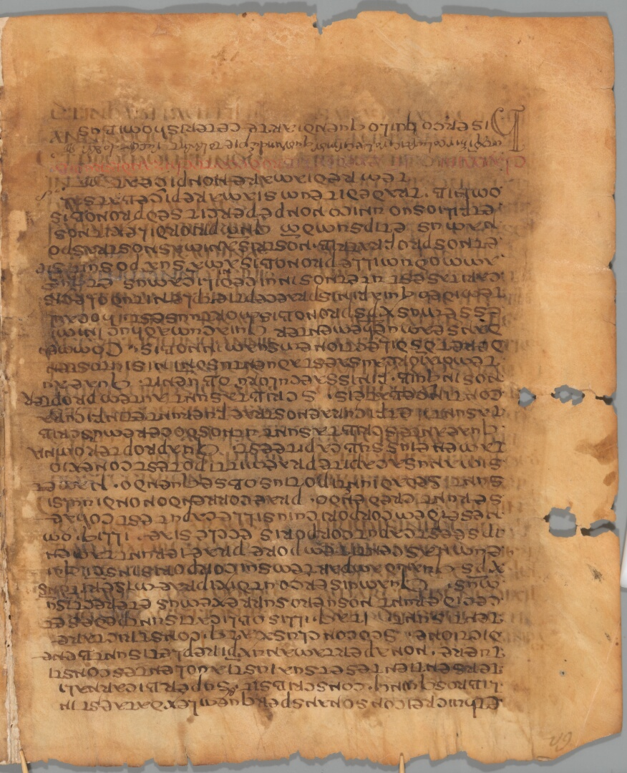
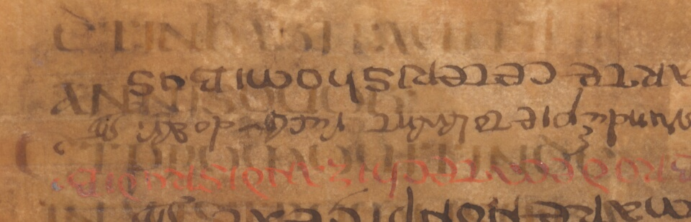
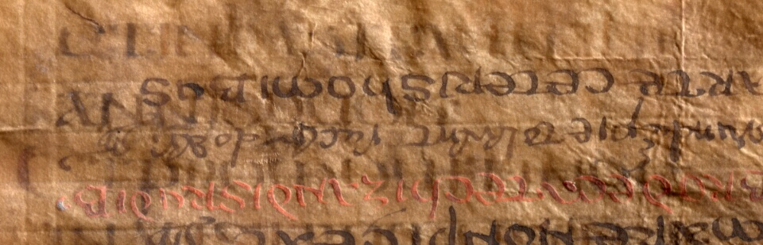
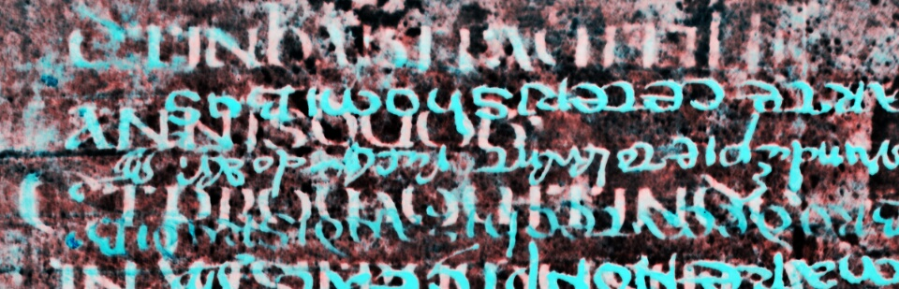
Notes:
https://palimpsest.stmarytx.edu/iiif/Ambrosiana_C73inf_062_Ac_00.jp2/218,768,5756,7096/,1080/0/default.jpg
https://palimpsest.stmarytx.edu/iiif/Ambrosiana_C73inf_062_Ac_00.jp2/494,1682,2392,770/960,/0/default.jpg
https://palimpsest.stmarytx.edu/iiif/Ambrosiana_C73inf_062_Ac_51.jp2/494,1682,2392,770/960,/0/default.jpg
https://palimpsest.stmarytx.edu/iiif/Ambrosiana_C73inf_062_TRH01_00.jp2/494,1682,2392,770/960,/0/default.jpg

Slide 3
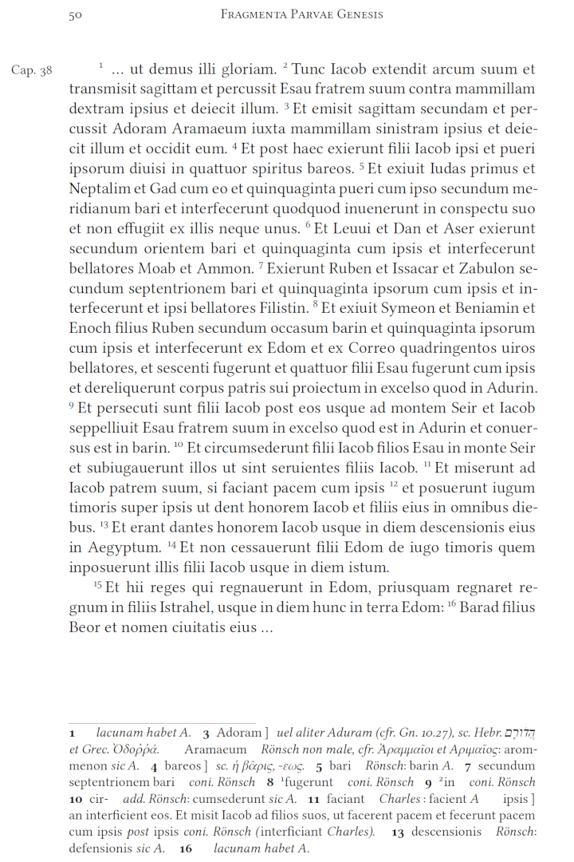
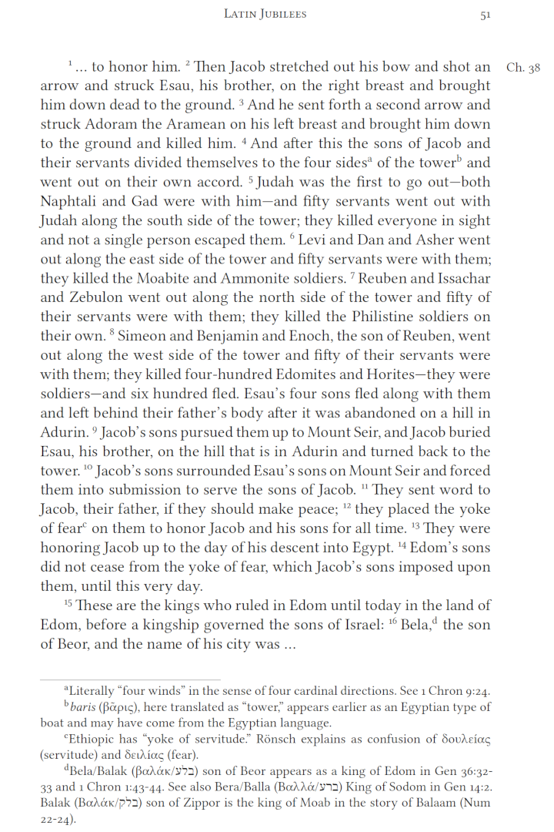

Slide 4
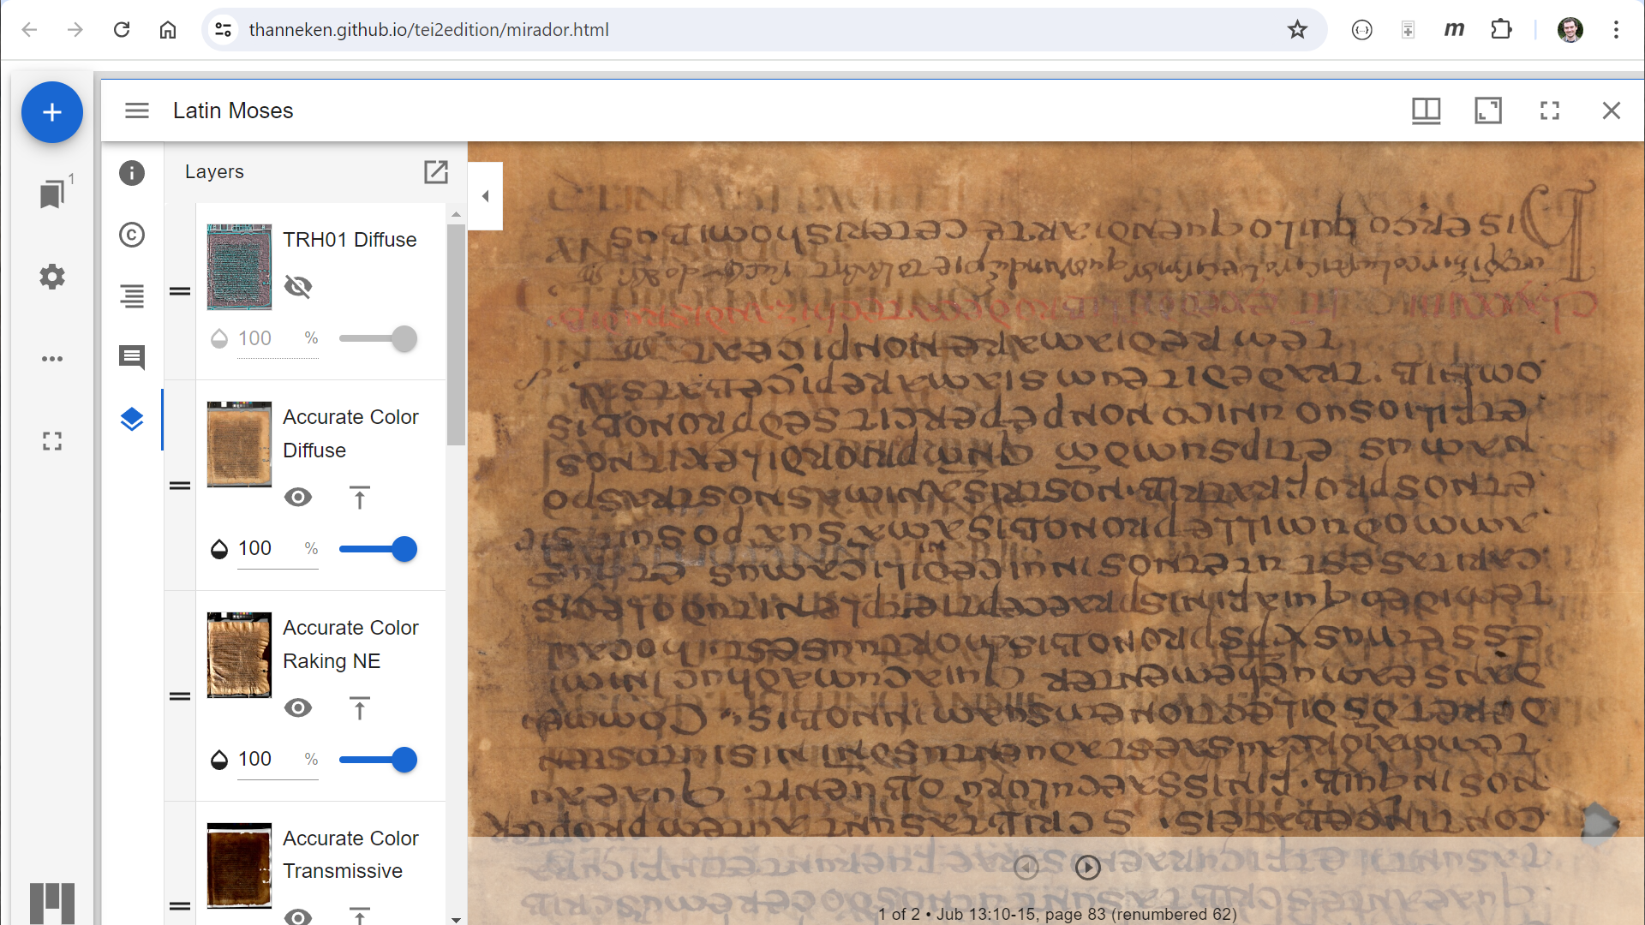

Slide 5
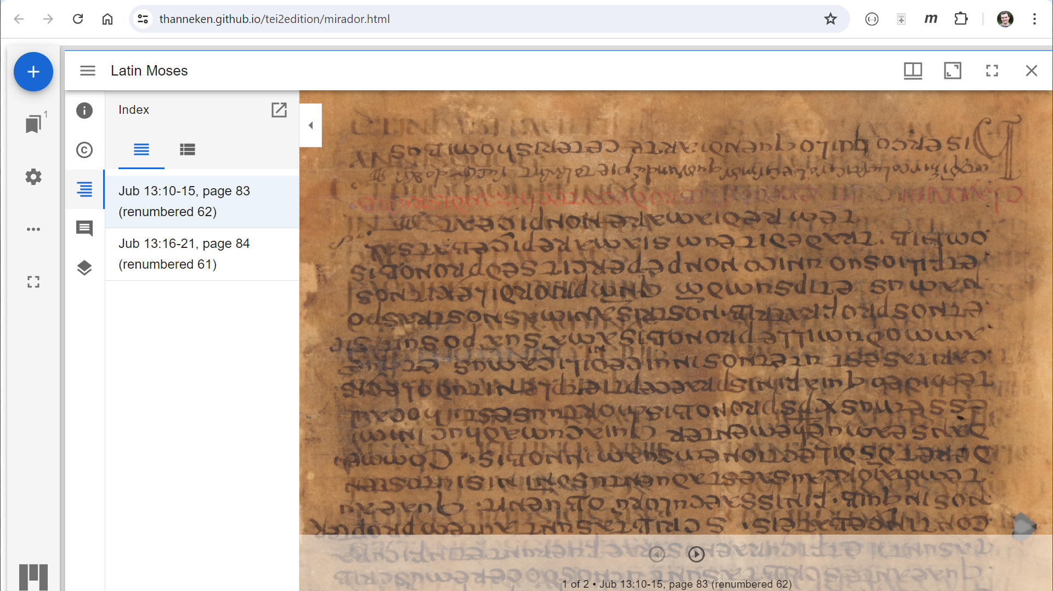

Slide 6
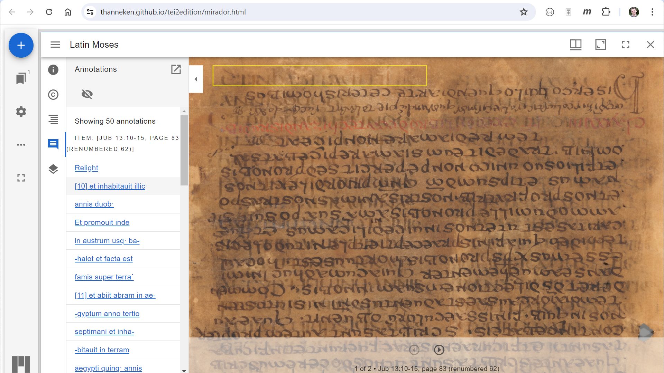

Slide 7
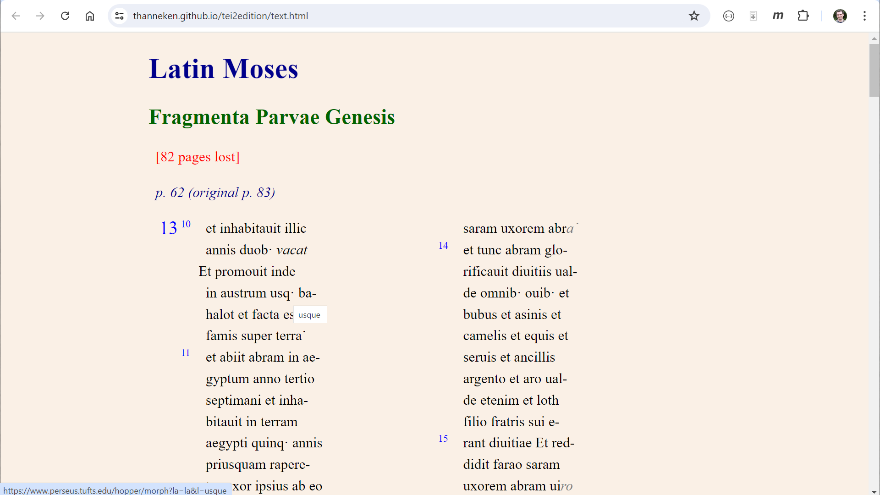

Slide 8
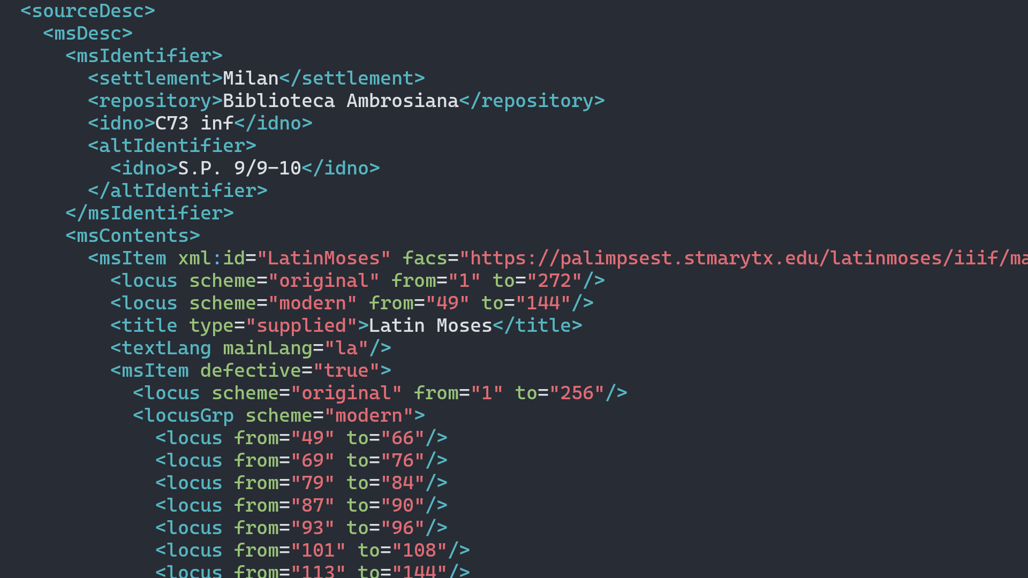

Slide 9
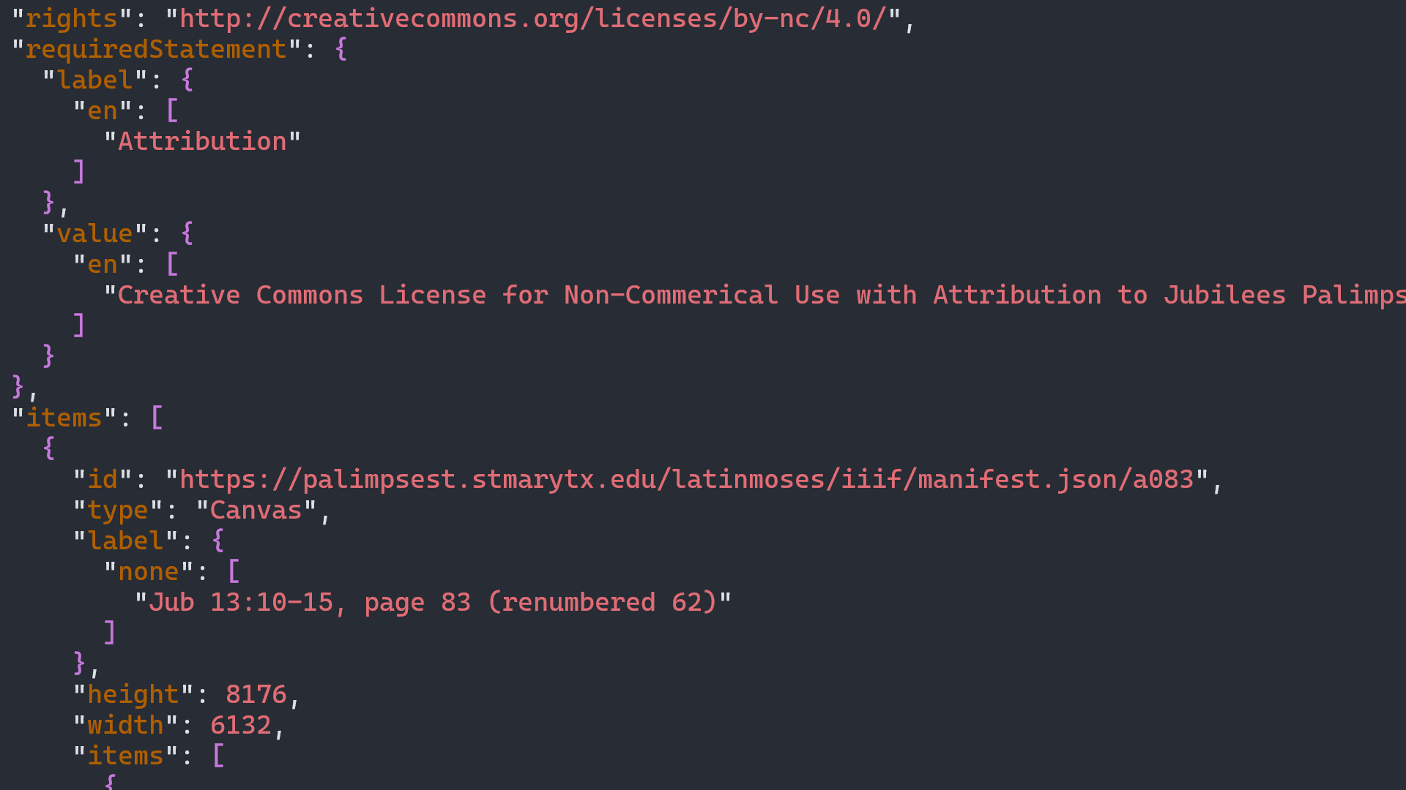

Slide 10
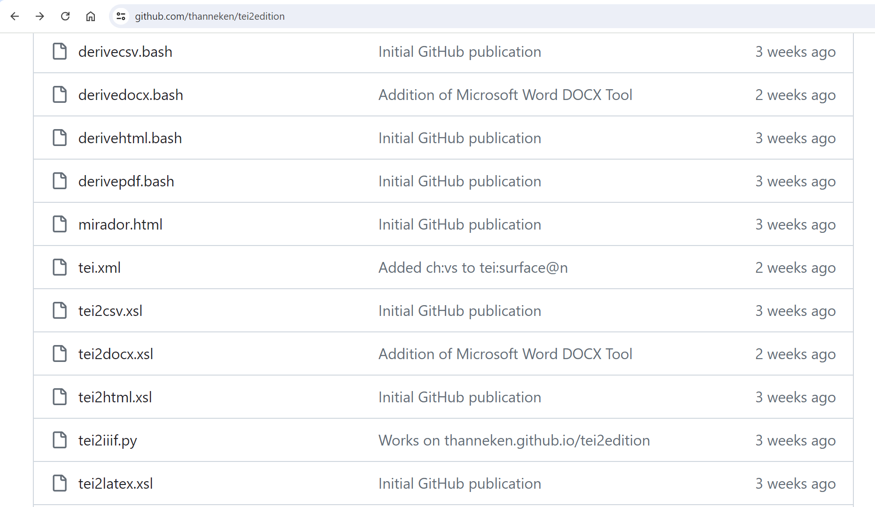

Slide 11
TEI and IIIF Corresponding Concepts
tei:facsimile
tei:surface
tei:graphic
tei:line
@ulx, @lrx, @uly, @lry
@height, @width
@xml:id
@n
@xml:lang
@corresp, @facs
manifest
canvas
image
annotation
x, y, w, h
height, width
id
label
language
target

Slide 12
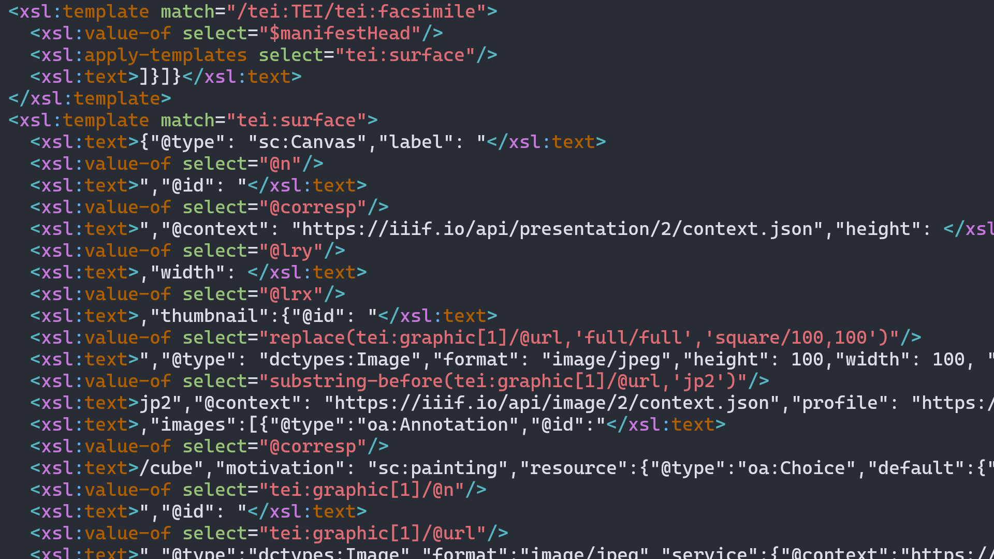

Slide 13
Conclusions
TEI suffices to encode all information necessary for print, hypertext, and facsimile viewer editions
IIIF Presentation manifests can be thought of as just another visualization rendered by XSLT
Minimal computing fosters accessible, sustainable, and adaptable scholarship

Slide 14

Streamlining Text Encoding Initiative (TEI), International Image Interoperability Framework (IIIF), and Mirador: Theoretical and Practical Considerations for Interactive Critical Editions
Todd Hanneken
St. Mary’s University, San Antonio
thanneken@stmarytx.edu
https://palimpsest.stmarytx.edu/thanneken/
@thanneken@hcommons.social
https://palimpsest.stmarytx.edu/thanneken/2024/dh/
Notes:
https://cdn.stmarytx.edu/wp-content/uploads/2021/03/DJI_0900-2.jpg

